Slide 1
PROJECT VIVA
Python Programming Lab (22CS001)
Dated: 10th November 2022
Department of Computer Science and Engineering,
Chitkara University, Punjab
Submitted By:
Student Name:
Rollno :
Group: CSE-G21(A/B)
Sem:

Slide 2

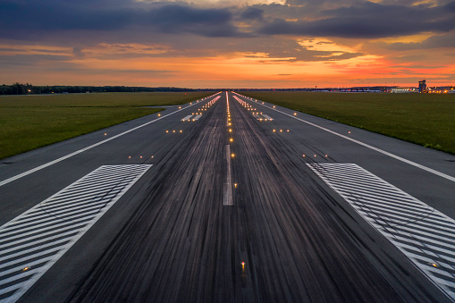
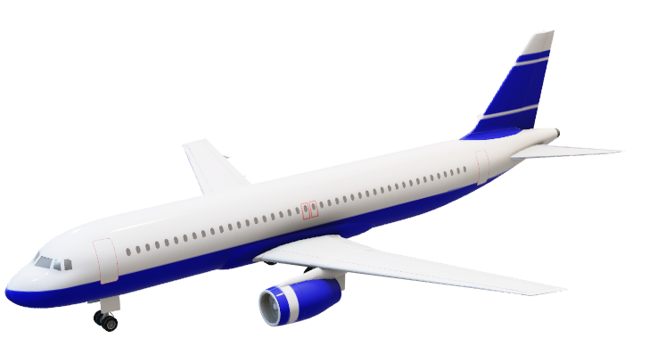
TIME TO travel
By Chitkara Airlines
WELCOME TO
Chitkara Airlines

Slide 3

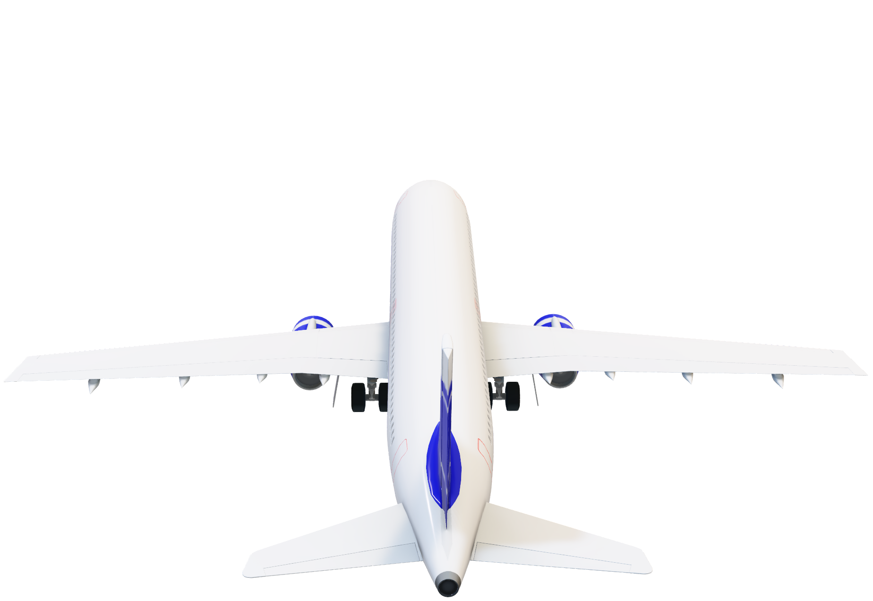
TIME TO TRAVEL
By Chitkara Airlines
WELCOME TO
Chitkara Airlines

Slide 4
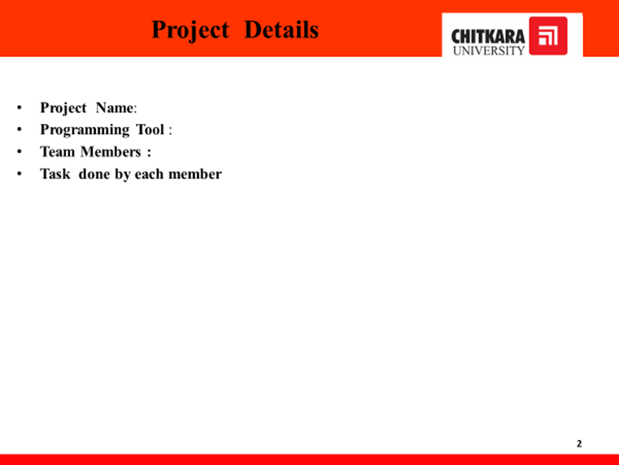

Slide 5
INTRODUCTION
Airline management System is a computerized system used to store and retrieve information, book flights, cancel flights etc. The project is aimed at enhancing the relationship between customers and airline agencies .
This project helps to build a interface between the airline companies and the passengers so that they can book tickets from anywhere in the world. The system should ask for the travel from and travel to cities and countries.

Slide 6
OBJECTIVE
To manage the details of airline tickets ,flights, bookings , passengers , booking counter.
It is build at user’s end
It tracks all the details about the bookings , passengers , booking counter.
To reduce the manual work for managing the airline tickets , flights, bookings.

Slide 7



Slide 8

Future Scope
We will host the platform on online servers to make it accessible worldwide.
Integrate multiple load balancers to distribute the loads of the system .
Implement the backup mechanism for taking backup of code base and data base on regular basis on different servers.

Slide 9
Pros and cons
The project will help users to easily book tickets with just a few clicks.
Easy cancellation policy.
Travelers can book flights for both domestic and international flights easily from anywhere at any time.
Travelers can also upgrade their from economic to first class

Slide 10
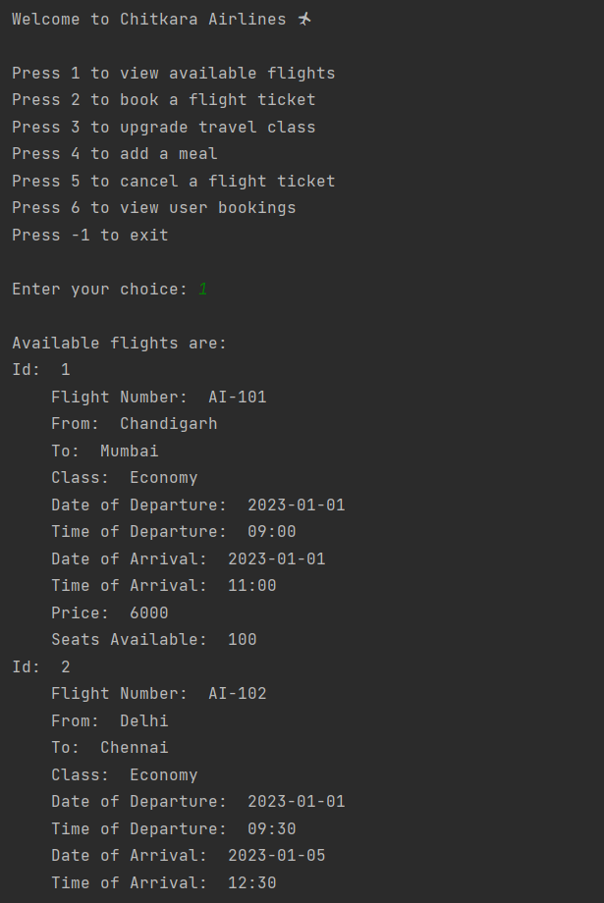
Checking Availability…
The details for each flight will be shown as: id, flight number, from – to, date of departure and arrival, price of the flight per passenger and seats available.

Slide 11

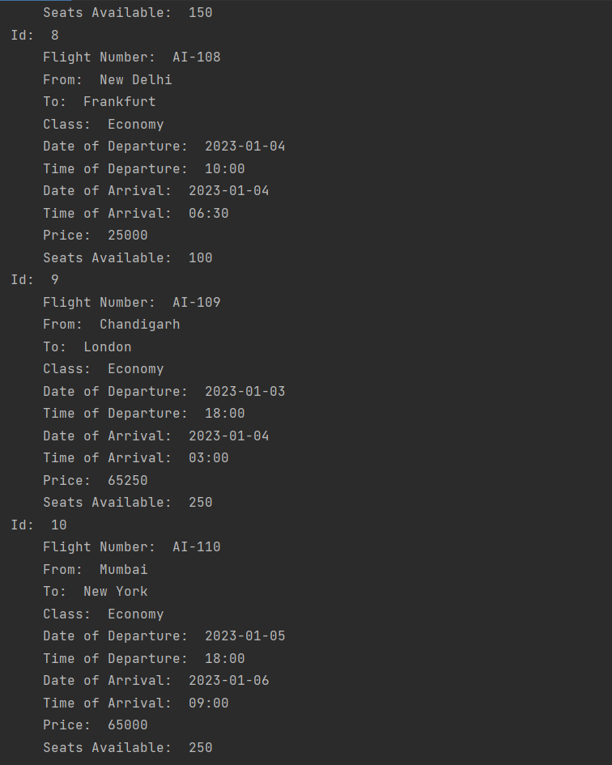
International Flights!!
FLY AROUND THE WORLD

Slide 12
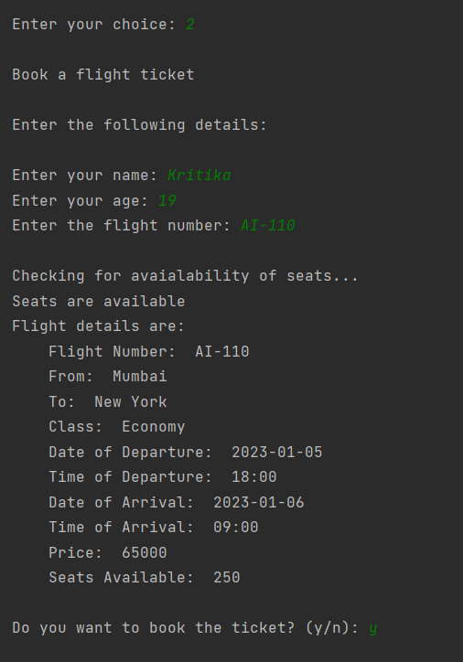
Book a flight !
Enter the following details to book a flight:
name, age and flight number.

Slide 13
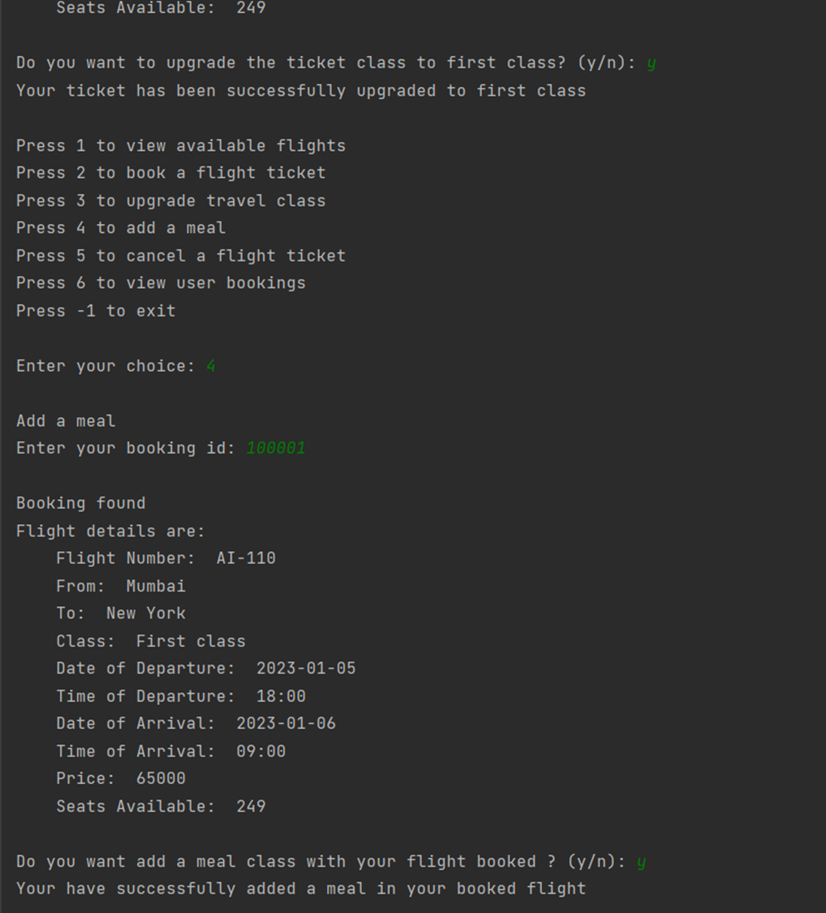
Add meals to your flight..

Slide 14
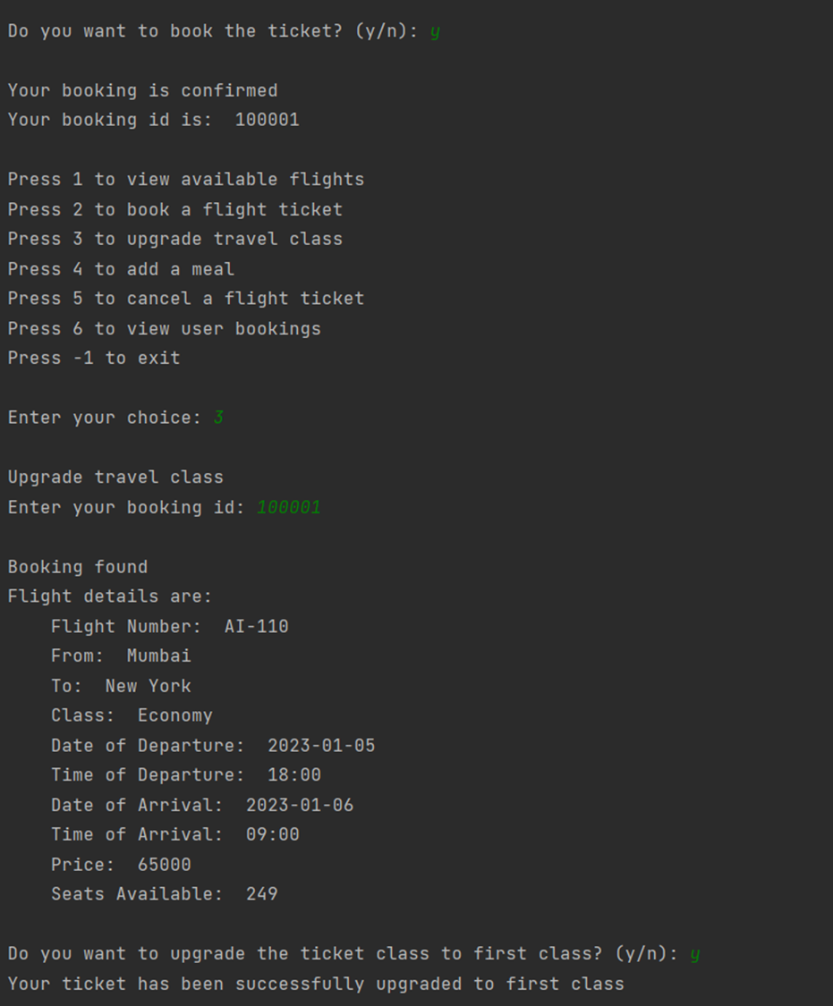

Upgrade your class…

Slide 15
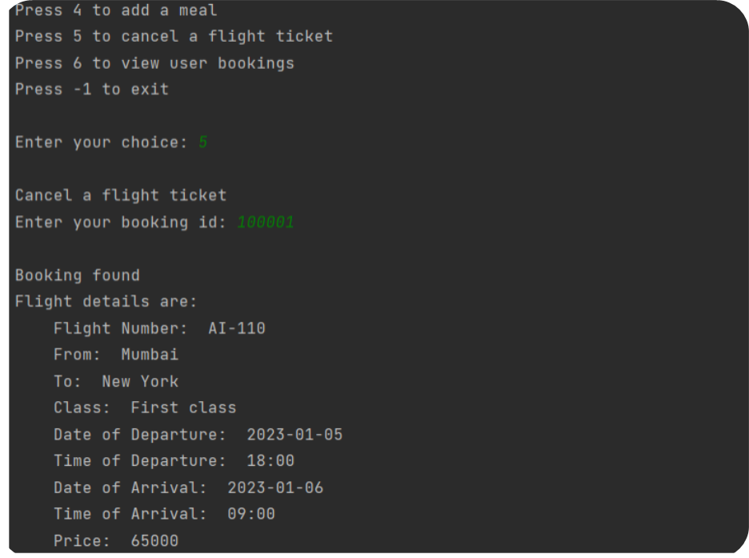
Cancel your bookings…
Enter booking ID and then user will be able to cancel the flight with the help of a unique booking id without any cancellation charges.

Slide 16
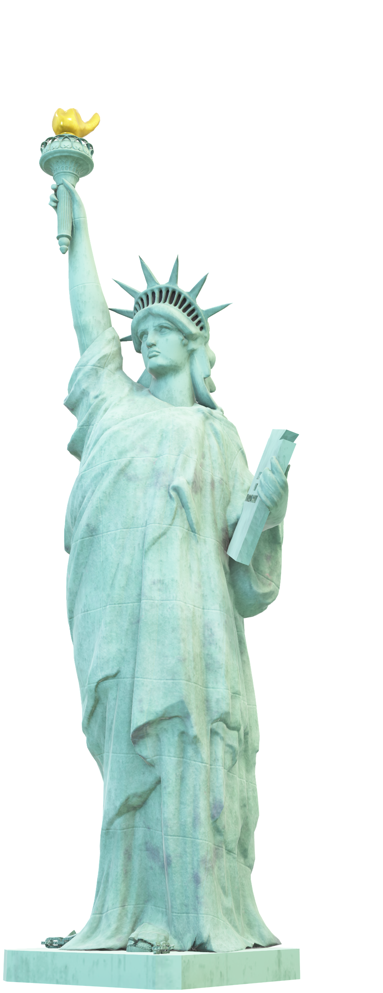
CONCLUSION
THE AIM OF PROPOSED SYSTEM IS TO DEVELOP A SYSTEM OF IMPROVED FACILITIES.
THE SYSTEM PROVIDES PROPER SECURITY WITH AN UNIQUE BOOKING ID AND REDUCES THE MANUAL WORK WITH GREATER EFFICIENCY.
IT IS USER FRIENDLY AND INTERACTIVE WITH MINIMUM TIME NEEDED FOR THE VARIOUS PROCESSING.

Slide 17

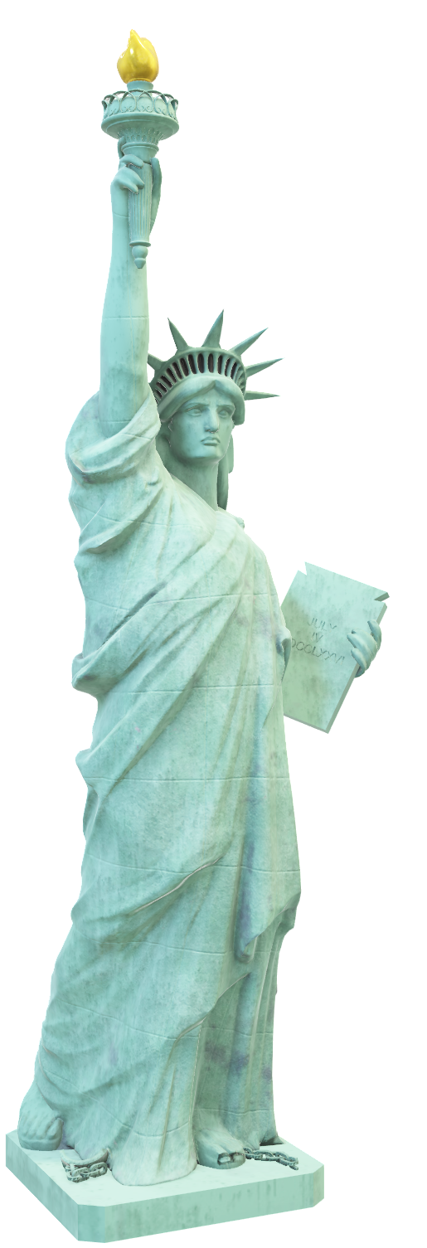
THANK YOU FOR VISITING CHITKARA AIRLINES

